Slide 1
A primer on Supervised Learning
Prof. Sebastián Vallejo Vera

Slide 2
So far…
We started from pre-processing text as data, representing text as numbers, and describing features of the text.
Last week, we started measurement and classification:
Dictionary methods
Discuss some well-known dictionaries
Scaling techniques
Wordfish
Topic modeling
Structural Topic Models

Slide 3
From dictionaries to supervised learning
How can we systematically classify text into meaningful categories (e.g., positive/negative, hate vs. non-hate speech, spam vs. non-spam)?
Goal: Learn a function f that maps text inputs x to category outputs y
Dictionaries: Mapping function is explicitly defined by the researcher using predefined word lists
Supervised Classification: Mapping function is learned from the data by training an algorithm to predict categories based on labeled documents

Slide 4
Supervised scaling techniques

Slide 5
Laver et al.’s (2003) Wordscores
Let’s start with an early example that uses labeled documents to predict the position of a text on an (ideological) scale.
Wordscores uses reference documents with known or assumed positions (the equivalent of a training set) to score virgin documents.
In this case, the reference documents = labeled documents.

Slide 6
The process is as follows:
We give each reference text r an a priori score A.

Slide 7
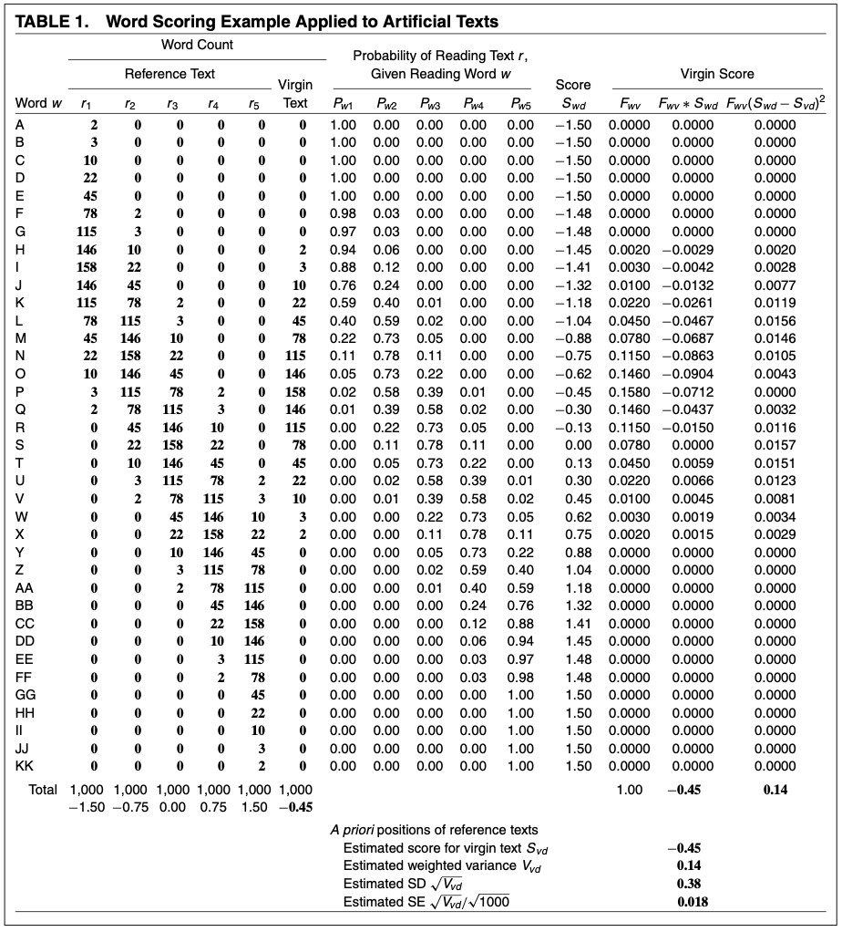
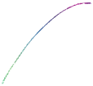

Slide 8
The process is as follows:
We give each reference text r an a priori score A.
We count the number of words w that occur in reference text r.

Slide 9
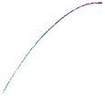

Slide 10
The process is as follows:
We give each reference text r an a priori score A.
We count the number of words w that occur in reference text r.
We estimate the probability P of reading text r, given word w.

Slide 11
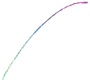

Slide 12
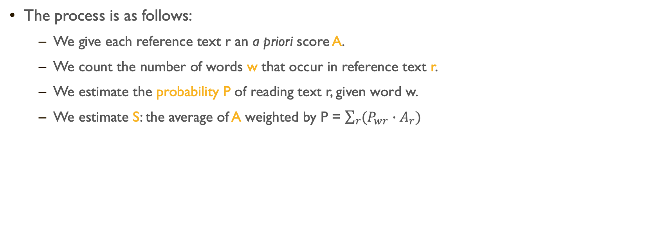
The process is as follows:
We give each reference text r an a priori score A.
We count the number of words w that occur in reference text r.
We estimate the probability P of reading text r, given word w.
We estimate S: the average of A weighted by P = $\sum_{r}{(P_{wr}}∙A_{r})$

Slide 13
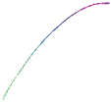

Slide 14
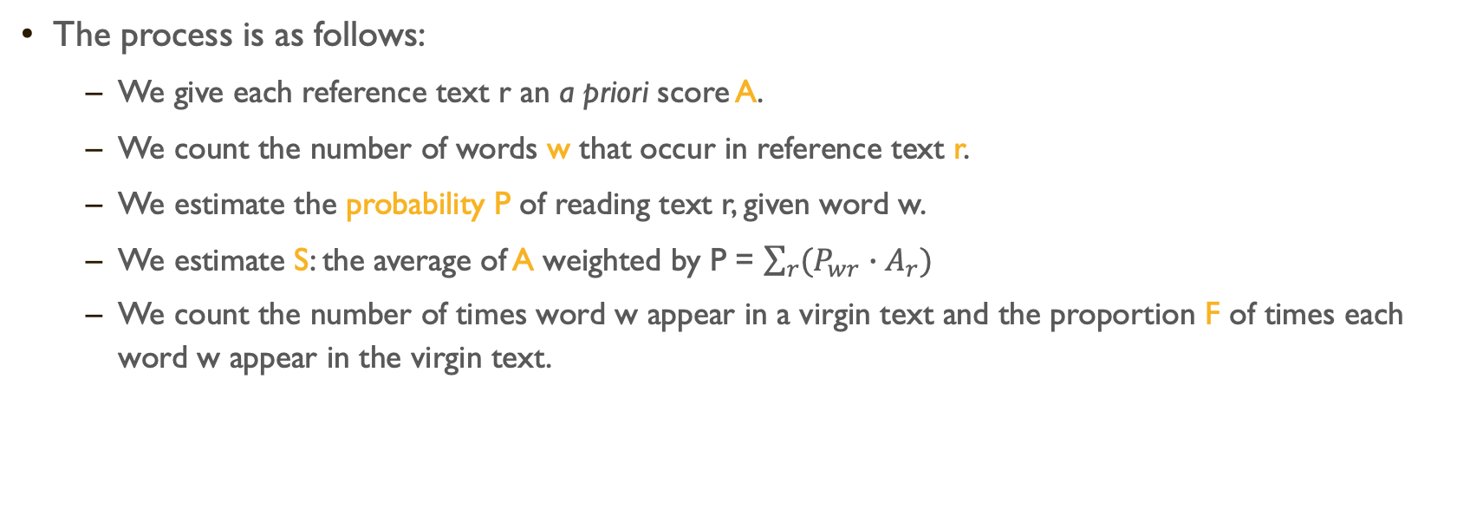
The process is as follows:
We give each reference text r an a priori score A.
We count the number of words w that occur in reference text r.
We estimate the probability P of reading text r, given word w.
We estimate S: the average of A weighted by P = $\sum_{r}{(P_{wr}}∙A_{r})$
We count the number of times word w appear in a virgin text and the proportion F of times each word w appear in the virgin text.

Slide 15
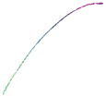

Slide 16
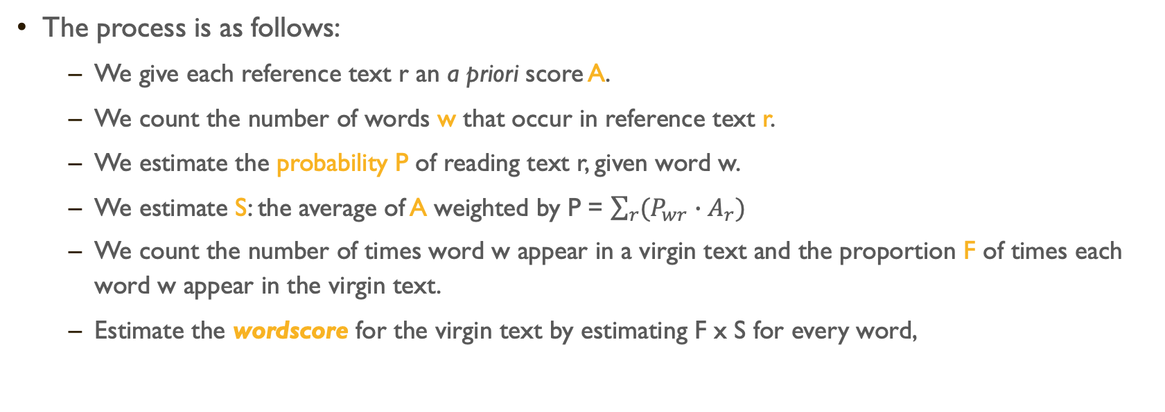
The process is as follows:
We give each reference text r an a priori score A.
We count the number of words w that occur in reference text r.
We estimate the probability P of reading text r, given word w.
We estimate S: the average of A weighted by P = $\sum_{r}{(P_{wr}}∙A_{r})$
We count the number of times word w appear in a virgin text and the proportion F of times each word w appear in the virgin text.
Estimate the wordscore for the virgin text by estimating F x S for every word,

Slide 17
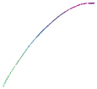

Slide 18
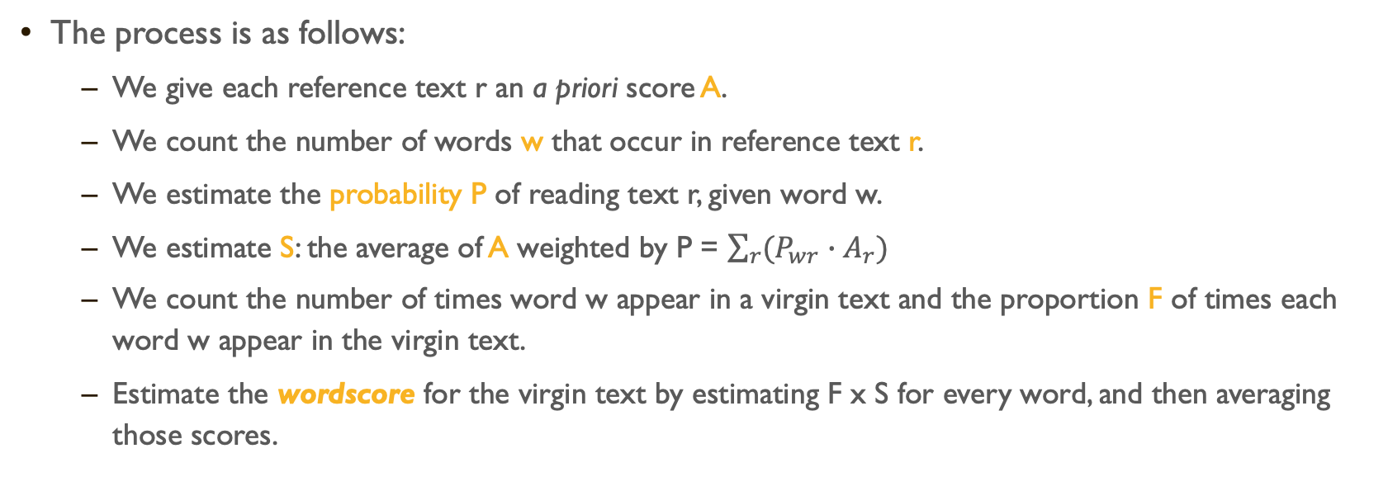
The process is as follows:
We give each reference text r an a priori score A.
We count the number of words w that occur in reference text r.
We estimate the probability P of reading text r, given word w.
We estimate S: the average of A weighted by P = $\sum_{r}{(P_{wr}}∙A_{r})$
We count the number of times word w appear in a virgin text and the proportion F of times each word w appear in the virgin text.
Estimate the wordscore for the virgin text by estimating F x S for every word, and then averaging those scores.
Notes:
What is the function f() that we are trying to map?

Slide 19


Slide 20
That way we can put the virgin text in a dimension relative to the reference words.
And this seems to work:

Slide 21
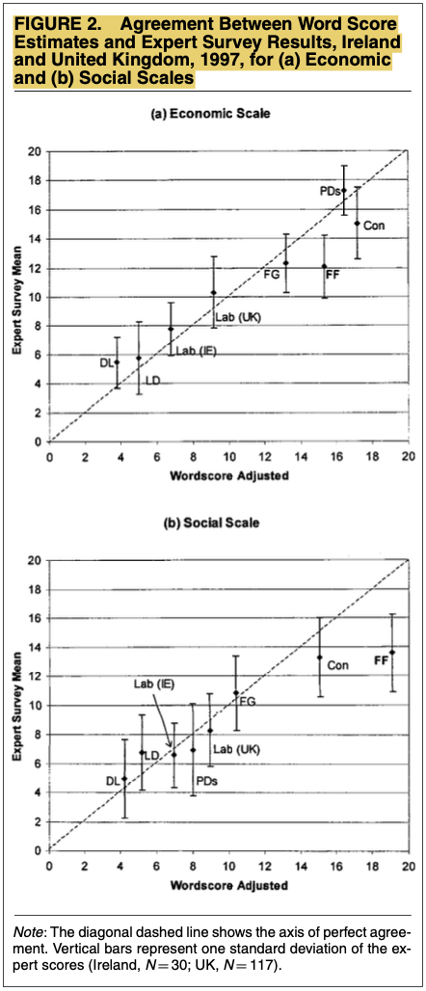

Slide 22
There are some methodological issues (see Slapin and Proksch 2008):
Technique doesn’t recover estimates of “virgin” texts on same scale as reference texts (see Martin and Vanberg 2008)
Difficult to find reference texts + appropriate a priori measures of document-level ground truth positions
Cannot be straightforwardly used for estimates of over-time variation
Further ahead, we will see that there is no updating (no loss function) in this approach, and, thus, no real sense of what is the ground truth.
Notes:
Let’s head to the website!!

Slide 23
Let’s see this in action! (see: https://svallejovera.github.io/cta_updated/week7.html#wordscores)

Slide 24
The intuition behind Supervised Machine Learning

Slide 25
In Week 5 we talked about Clustering and Topic Modeling.
All of these techniques fall within that category of unsupervised learning. Why unsupervised? Well, because we make certain assumption about the data generating process, then allow the machine to order the data based on those assumptions, and then we imposed meaning to the order.

Slide 26
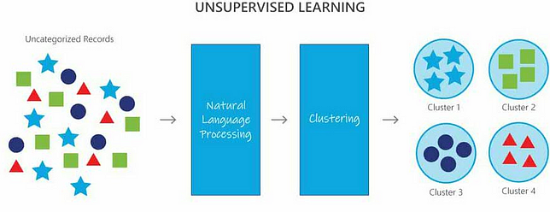

Slide 27
In Week 5 we talked about Clustering and Topic Modeling.
All of these techniques fall within that category of unsupervised learning. Why unsupervised? Well, because we make certain assumption about the data generating process, then allow the machine to order the data based on those assumptions, and then we imposed meaning to the order.
But, what if we have a ground truth about a concept captured by our data, and we want an algorithm to understand the data to predict that concept.

Slide 28


Labeled Data
(Ground Truth)
Black Magic
Prediction
It’s a dog!
or
It’s a cat!

Slide 29
Labeled Data
Black Magic
Machine Learning Model
Prediction
It’s a dog!
or
It’s a cat!

Slide 30
What is Supervised Learning?

Slide 31
Supervised Machine Learning is machine learning algorithm type that requires labeled input data to understand the mapping function from the input to the output
SUPERVISED: The true labels y act as a “supervisor” for the learning process
Model predicts y-hat for each input x
Compare predictions y-hat to true labels y
Adjust model to minimize errors
LEARNING: the process by which a machine/model improves its performance on a specific task

Slide 32
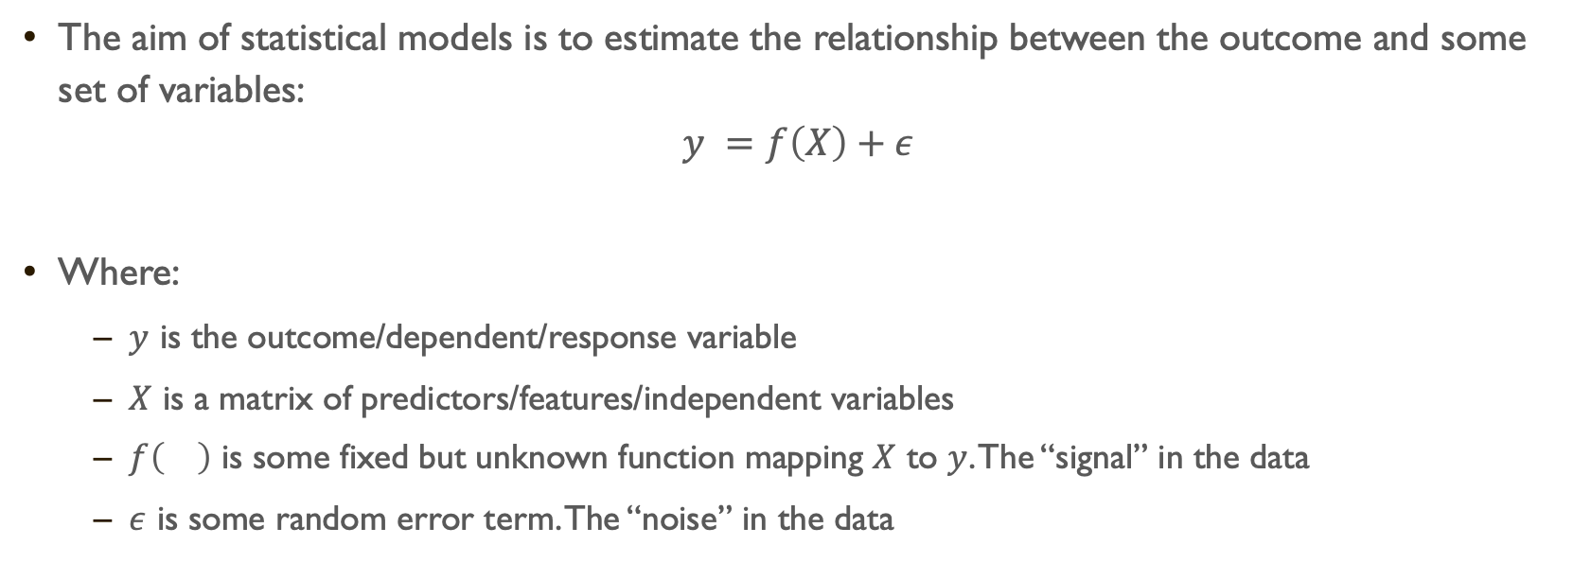
The Statistical Model
The aim of statistical models is to estimate the relationship between the outcome and some set of variables:
$$y =f\left(X\right)+ε$$
Where:
$y$ is the outcome/dependent/response variable
$X$ is a matrix of predictors/features/independent variables
$f\left(\right)$ is some fixed but unknown function mapping $X$ to $y$. The “signal” in the data
$ε$ is some random error term. The “noise” in the data

Slide 33
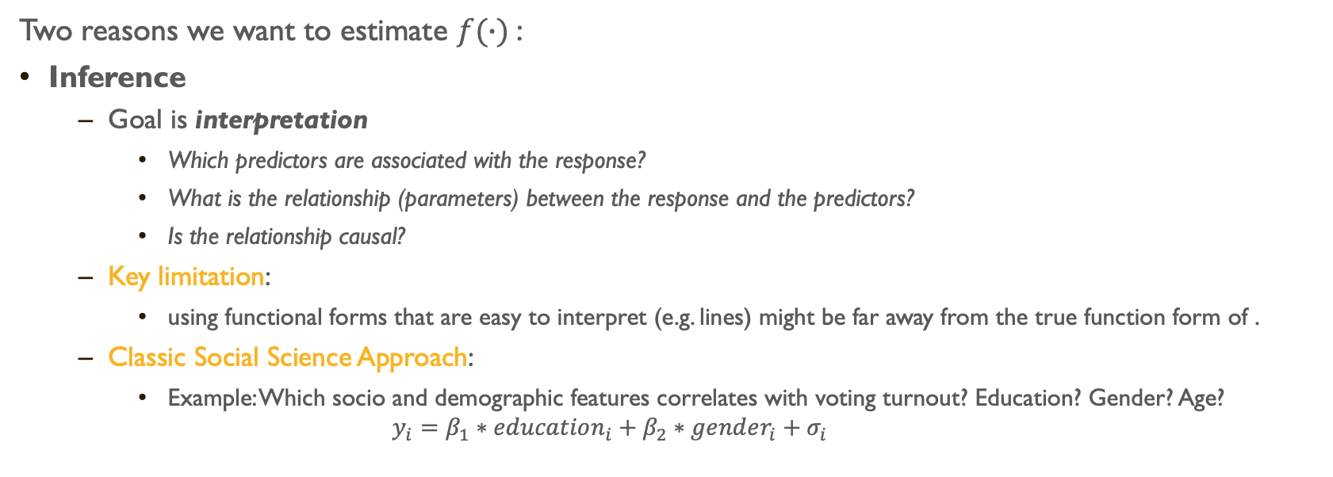
Inference (social Science) vs Prediction (Machine Learning)
Two reasons we want to estimate $f(∙)$:
Inference
Goal is interpretation
Which predictors are associated with the response?
What is the relationship (parameters) between the response and the predictors?
Is the relationship causal?
Key limitation:
using functional forms that are easy to interpret (e.g. lines) might be far away from the true function form of .
Classic Social Science Approach:
Example: Which socio and demographic features correlates with voting turnout? Education? Gender? Age?
$$y_{i}=β_{1}∗education_{i}+β_{2}∗gender_{i}+σ_{i}$$

Slide 34
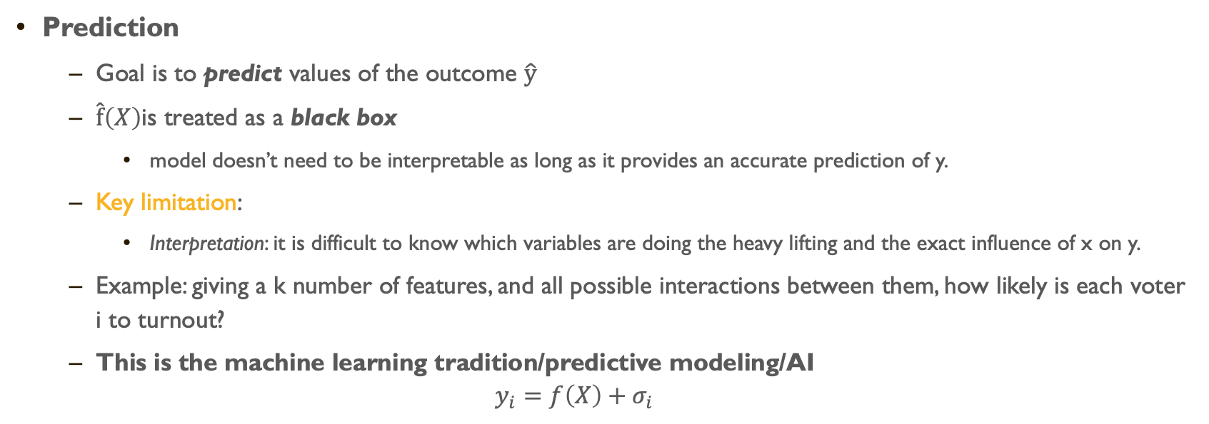
Inference (Social Science) vs Prediction (Machine Learning)
Prediction
Goal is to predict values of the outcome $\hat{y}$
$\hat{f}\left(X\right)$is treated as a black box
model doesn’t need to be interpretable as long as it provides an accurate prediction of y.
Key limitation:
Interpretation: it is difficult to know which variables are doing the heavy lifting and the exact influence of x on y.
Example: giving a k number of features, and all possible interactions between them, how likely is each voter i to turnout?
This is the machine learning tradition/predictive modeling/AI
$$y_{i}=f\left(X\right)+σ_{i}$$

Slide 35
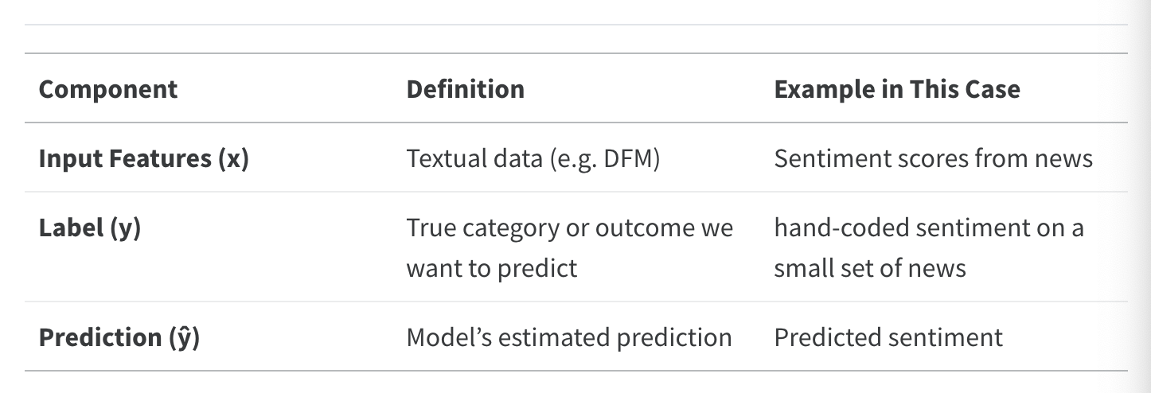
Supervised Learning in Text-as-Data

Slide 36
Barberá et al. (2021) provide an excellent guide for supervised text classification. They identify three steps required for SML. I have created a modified version of this:
Select a corpus
Create a training set
Choose and train an ML model
VALIDATE!
Let’s start!

Slide 37
1) Choose a Corpus

Slide 38
The choice of the corpus depends on the research question. What is the universe, or source, of text?
It can be well-defined, and small: speeches from the Canadian Parliament between 2000 and 2019.
It can be broader: media headlines between 2000 and 2019.
If the researcher has access to the universe of texts, then the decision is straightforward: that is your corpus.
If the researcher does not have access to the universe of texts then…

Slide 39
What is the preferred sampling strategy?
As researchers, we want a corpus the mimics the population. You want to include relevant objects (minimize false negatives) and exclude irrelevant objects (minimize false positives). Irrelevant texts will add noise to the final analysis and will add cost to the production of your training set.
Researchers also need to be wary about representation.
You want to maximize relevance and representation.

Slide 40
What sampling strategy to use when selecting a corpus?
Barberá et al. (2021) suggests using keyword search over topic search. However, it can vary by case, and, at the end of the day, what you want to avoid, as with any sample, is selection bias.
For a more detailed explanation, see Barberá et al. (2021), p. 20-24.

Slide 41
2) Creating a Training Set

Slide 42
There are crucial decision that the researcher need to make when building their training set:
Unit of analysis.
Note that the UoA does not need to necessarily correspond to the UoA of your final dataset.
Sampling procedure.
Categories and number of observations.
Coders.

Slide 43
Unit of Analysis
When deciding on the UoA, think about the following questions:
What am I trying to identify in the text?
Can my category of analysis change throughout the text?
There are assumptions that you are making about this depending on the model you choose.
If it changes, am I interested in an aggregated element? Would I prefer the disaggregated chunks?
How much noise am I adding by choosing a longer UoA?
How much information am I losing by choosing a shorter UoA?
What is the optimal UoA for me (as a human coder) to identify the element that I am interested in?

Slide 44
Sampling procedure
So, you have one million speeches/tweets/manifestos/answers/etc. Should I randomly sample N documents and code them?
As always, it depends. When we are training an ML model, we are showing it some data. For the ML model, that is the world it knows.
If you tell the model that in the world there are either cats or dogs, and you show it a parrot, it will try to fit the parrot within the categories it knows (cats or dogs).
But also, if you show it a lion (which you would have categorized as a cat), and it has never seen a lion before, it will have a hard time deciding
Thus, your sample should be both, representative of the categories to be predicted, and of the different ways each category can be present in your sample.

Slide 45
What if my categories are ‘naturally’ unbalanced (i.e., the distribution of categories in a dataset are not uniform)? Should I oversample the smaller category? Should I undersample the larger category? Should I maintain an unbalanced dataset?
According to Mohammed et al. (2020), you get better results by oversampling (but this has not been always my experience). Regardless of the route you choose, you always need to validate your results.

Slide 46
Categories and number of observations
How many categories should I choose? The straightforward answer is as many as you need.
BUT, and this is a theoretical but, always consider whether the categories are exclusionary.
For machines, as well as for humans, dichotomous categories are easier to predict than multinomial categories. If theoretically plausible, try to have dichotomous training sets (or training sets with few categories).*

Slide 47
The number of observations in your training set will depend on the complexity of the task and the ML model you are using (more on this later).
However, Kaufman (2024) propose a method to select more informative training sets with fewer observations that achieve similar performance than randomly sampled training sets.

Slide 48
coders
Now that you have a training set, you need to get some coders.
Barbera et al. (2021) suggest:
More Unique Documents (thus fewer coders per document): More information in the training dataset, and thus better performance of the classifier.
More Coders per Document (thus coding fewer unique documents): Allows identification of better/worse coders.
But ultimately: For any fixed number of total codings, maximize the number of unique documents coded.

Slide 49
3) Choose and train an ML model

Slide 50
A classifier is a statistical model that assigns data points to a range of categories or classes.
In text as data, often your dfm has Features > Documents
identification problems for statistical models
overfitting the data with noise
Bias-variance trade-off
fit an overly complicated model ~ leads to higher variance
fit a more flexible model ~ leads to more bias
Many models:
Naive Bayes, Regularized regression, SVM, k-nearest neighbors, tree-based methods, ensemble methods + DL
Differences: loss function they minimize, model assumptions, regularization control (balance bias vs. variance), computational complexity

Slide 51
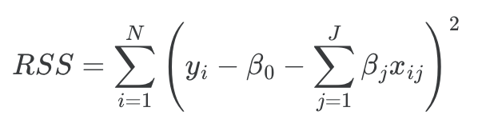
Regularized OLS Regression
The simplest, but highly effective, way to build ML models in text-as-data is to use a known model (OLS) + regularization to reduce dimensionality:
OLS Loss Function:
There are other, similar, functions such as:
OLS + ridge regression: penalizes large coefficients, shrinks all coefficients towards zero, but none are exactly zero.
OLS + lasso: penalized absolute size of coefficients, many coefficients shrink to exactly zero → automatic variable selection.

Slide 52
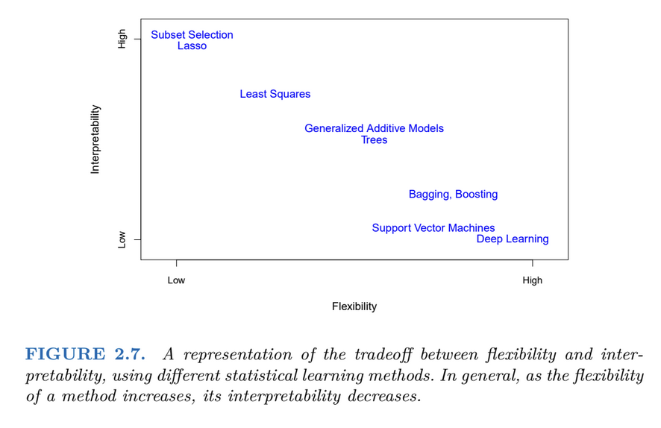

Slide 53
How to select a model?
The purpose of training the model is to capture signal and ignore noise.
To do so:
Define an accuracy metric: reduce this metric as much as possible. Simplest form: how many errors I am making with the predictions?
Train-Test Split
Split your data between training and test
Training data: find the best model and tune the parameters of these models
Test data: assess the accuracy of your model.
Select the model based on smaller out of sample predictive accuracy, using UNSEEN data.

Slide 54



Bias and Variance Trade-off
Expected prediction error for a data point:
Bias: Difference between the expected prediction of the model and the true value.
Variance: How much do the model’s predictions fluctuate for different training sets?
Bias and variance trade-off:
Can fit a very complicated model to our training set perfectly
Bias ↓, Variance ↑
Can be more relaxed about the performance in the training set
Bias ↑, Variance ↓

Slide 55
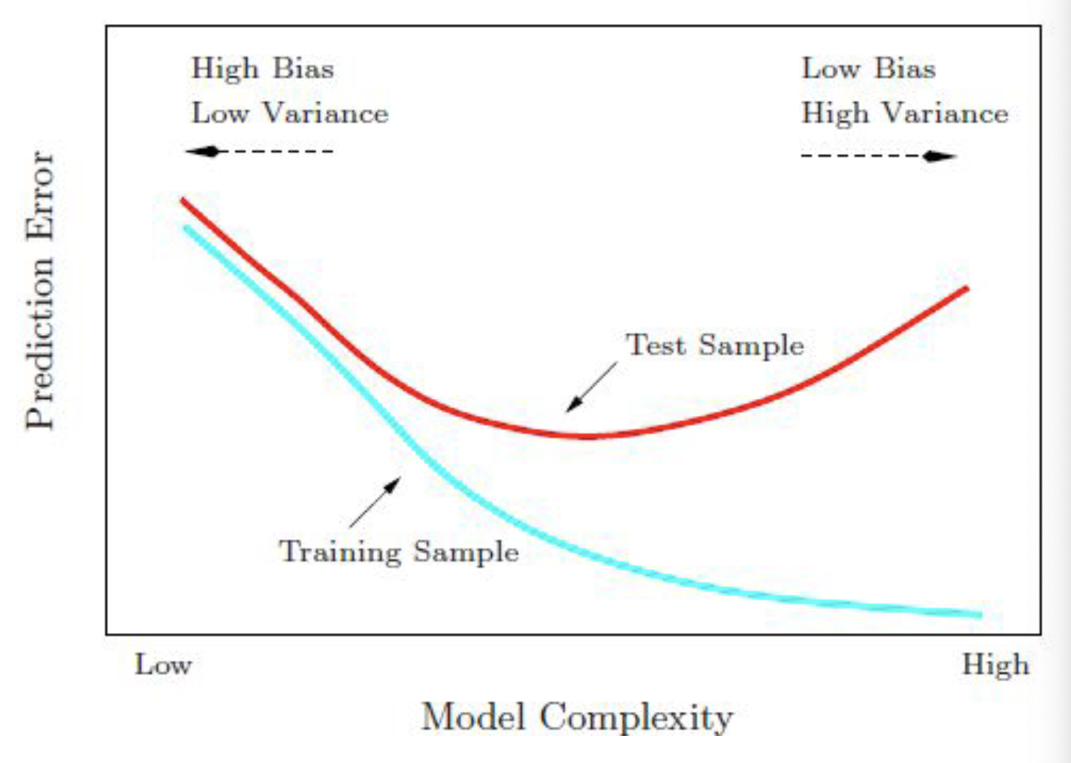
Notes:
What could go wrong?

Slide 56
In Weeks 8 to 9 we will learn about the following:
Support Vector Machine (SVM)
Bidirectional Long-Short Term Memory (Bi-LSTM) models.
Transformers-based ML models.
Why you should probably go directly to https://huggingface.co/ for all your ML needs.

Slide 57
4) Validate

Slide 58
Once you have trained your model, you will be able to test it. The first and second performance statistics will come from the training set itself (training and test set; cross-validation).
The third validation comes from outside the training set (out-of-sample validation).

Slide 59
Train-Validation-Test
Training Set
Largest portion (60-80% of the data)
To train the model
Validation Set
Smaller portion (10-20% of data)
Check different models
To tune hyperparameters and evaluate model during training
Parameters that we set before training begins (e.g. learning rate, number of neural networks layers, strength of regularization)
Test Set
Smaller portion (10-20% of data) - To assess final model performance

Slide 60
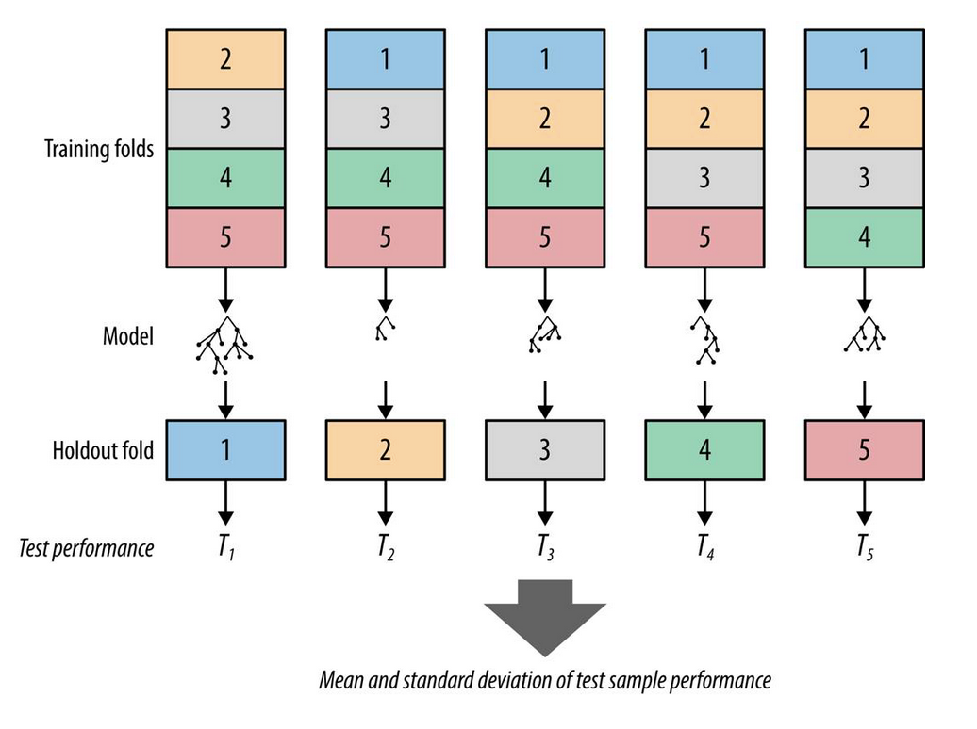
Cross-Validation
Cross-validation: resampling method that involves partitioning data into subsets, allowing us to train and test on different combinations
And then you validate out-of-sample…

Slide 61
Final Words
To evaluate performance there are a number of metrics commonly used in machine learning. We will learn about this when training our models.
You might be wondering “ok, but how do I choose from the gazillion classifiers out there?”
It depends on the task, but given the current state of the field + access to cloud computing + costs + AI, I believe that Transformers-based models outperform most approaches.
Note that this is a personal idiosyncratic believe, and people are likely to disagree.

